Slide 1
IoT-Enabled Supply Chain Monitoring:
Cold-Chain Risk Detection, Environmental Visibility and Supply Chain Transparency
Abubakar Umar Dangi
Msc – Data Science
Data Visulazation

Slide 2
Project Overview
This project investigates how IoT sensor data can improve cold-chain supply chain monitoring. Temperature readings, shipment locations and carbon emissions were analysed to identify operational risks and demonstrate how interactive visualisation supports logistics decision-making.
Objectives.
Monitor shipment temperature.
Detect operational risk.
Visualise supply chain performance using an interactive dashboard.

Slide 3
Dataset
The project analysed a simulated IoT cold-chain shipment dataset consisting of four shipments and 580 sensor readings collected throughout the transportation process.
Each sensor record contained:
• Shipment ID
• Timestamp
• GPS location
• Temperature
• Journey stage
• Carbon dioxide emissions
• Temperature alerts
• Risk level

Slide 4
KEY ANALYTICAL FINDINGS
The notebook investigated ten analytical questions to understand shipment performance and operational risk.
The main findings were:
• Temperature exceeded safe thresholds in selected shipments.
• Alert frequency varied considerably between shipments.
• Operational risk increased during the middle stages of transport.
• Carbon emissions accumulated progressively throughout the shipment journey.
• Real-time monitoring detected temperature breaches approximately 3.86 hours earlier than checkpoint monitoring.
• IoT monitoring provides improved visibility for logistics managers and supports faster operational decision-making.

Slide 5
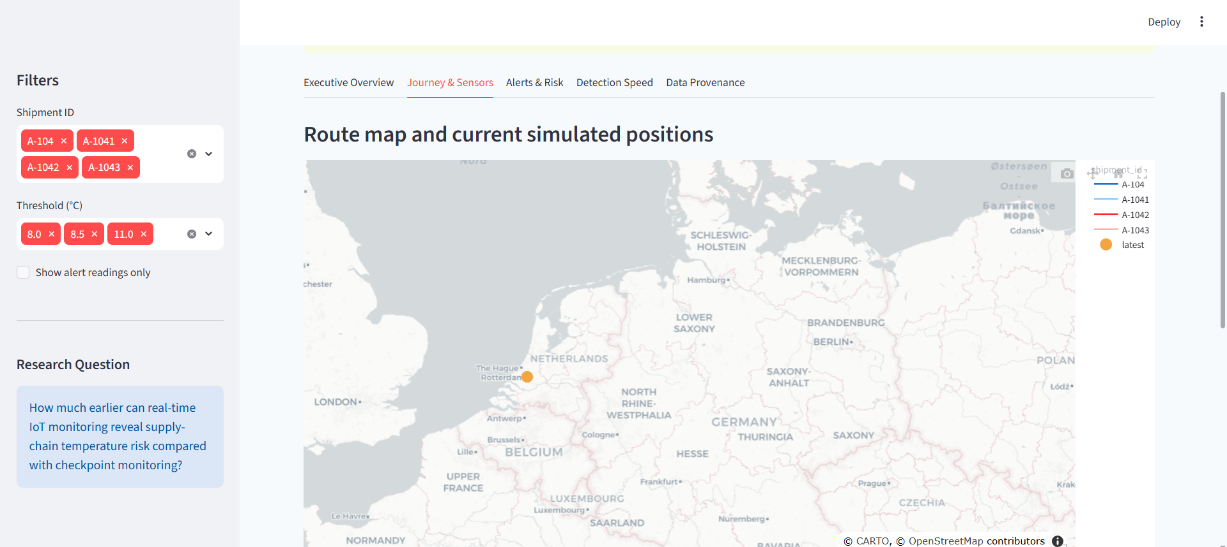
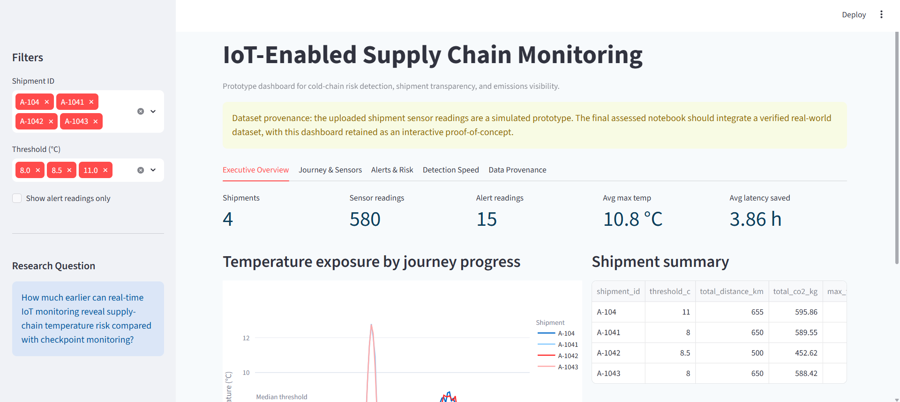
STREAMLIT DASHBOARD
Interactive Dashboard
An interactive Streamlit dashboard was developed to enable real-time exploration of shipment performance.
The dashboard includes the following sections:
Executive Overview
Displays key performance indicators including shipment count, sensor readings, temperature alerts, average maximum temperature, and average detection latency.
Journey & Sensors
Displays shipment routes, GPS locations, and environmental sensor measurements collected throughout the transportation process.
Alerts & Risk
Highlights temperature threshold breaches, high-risk shipments, and the stages where alerts occur most frequently.
Detection Speed
Compares real-time IoT monitoring with traditional checkpoint inspection and demonstrates the time saved through continuous monitoring.

Slide 6
Project Results
The project successfully demonstrated how IoT sensor data can improve cold-chain monitoring and supply chain transparency.
Results Summary
Four shipments were analysed.
• A total of 580 sensor readings were processed.
• Fifteen temperature alerts were detected.
• The average maximum shipment temperature was approximately 10.8°C.
• Real-time monitoring detected threshold breaches approximately 3.86 hours earlier than checkpoint monitoring.
The results show that continuous IoT monitoring enables earlier detection of operational issues, reduces response time, and supports proactive logistics management.

Slide 7
CONCLUSION
This project successfully developed an IoT-enabled supply chain monitoring system capable of analysing shipment temperature, operational risk, and environmental performance.
Interactive Plotly visualisations answered ten analytical questions, while the Streamlit dashboard provided an intuitive platform for monitoring shipment conditions and supporting operational decision-making.
The findings demonstrate that real-time IoT monitoring significantly improves visibility across the supply chain and enables earlier detection of temperature threshold breaches compared with traditional checkpoint inspections.

Slide 8
RECOMMENDATIONS
Based on the findings, the following recommendations are proposed:
• Integrate live IoT sensor data from real-world logistics operations.
• Apply machine learning techniques to predict shipment risk before threshold breaches occur.
• Expand the dashboard to monitor larger transportation networks.
• Integrate weather conditions, traffic information, and vehicle telemetry to improve prediction accuracy.
• Continue using interactive visualisation to support operational and sustainability decision-making.

